Slide 1
“Tree of Butterflies” (2000) Medoruma Shun (1960)
群蝶の木
目取真俊

Slide 2
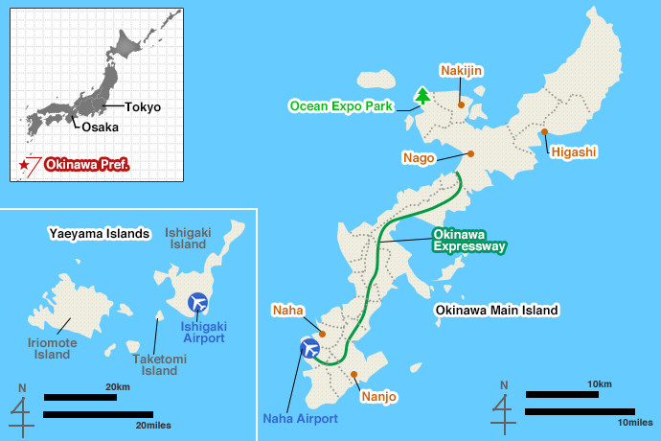
Map of Okinawa

Slide 3
Yûna tree
Notes:
Yellow butterflies

Slide 4
Keywords
Community: idealized? Criticized?
Tradition, modernization
Yanbaru forest
Intertextuality [Droplets (94), Taiwan Woman (87), Peace Street (79)]
Aging society
Temporality: flashbacks to childhood, BoO; prewar to present (83)
“Comfort station” & “Comfort women” [Pe Pongi]
https://kls.law.columbia.edu/content/online-resources-comfort-women
Double victimization by patriarchy: colonial and national
Adult age second generation war survivors attempts to comprehend Battle by means of vicarious imagination, oral storytelling
Notes:
Community center, priestesses asagi
CW: 130, 1000 Korean women, Tsuji destruction in 1944 (500 Ok women)

Slide 5
Discussion Questions
What do the yellow flowers of the yûna tree symbolize?
How is Gozei regarded by the village? Why? In what way does she engage in agency?
What is the “something” growing in Yoshiaki? (86)
What is the significance of the Village history Uchima compiles?

